Slide 1
Tutorial: Using PSP0.1
Personal Software ProcessSM for Engineers: Part I

Slide 2
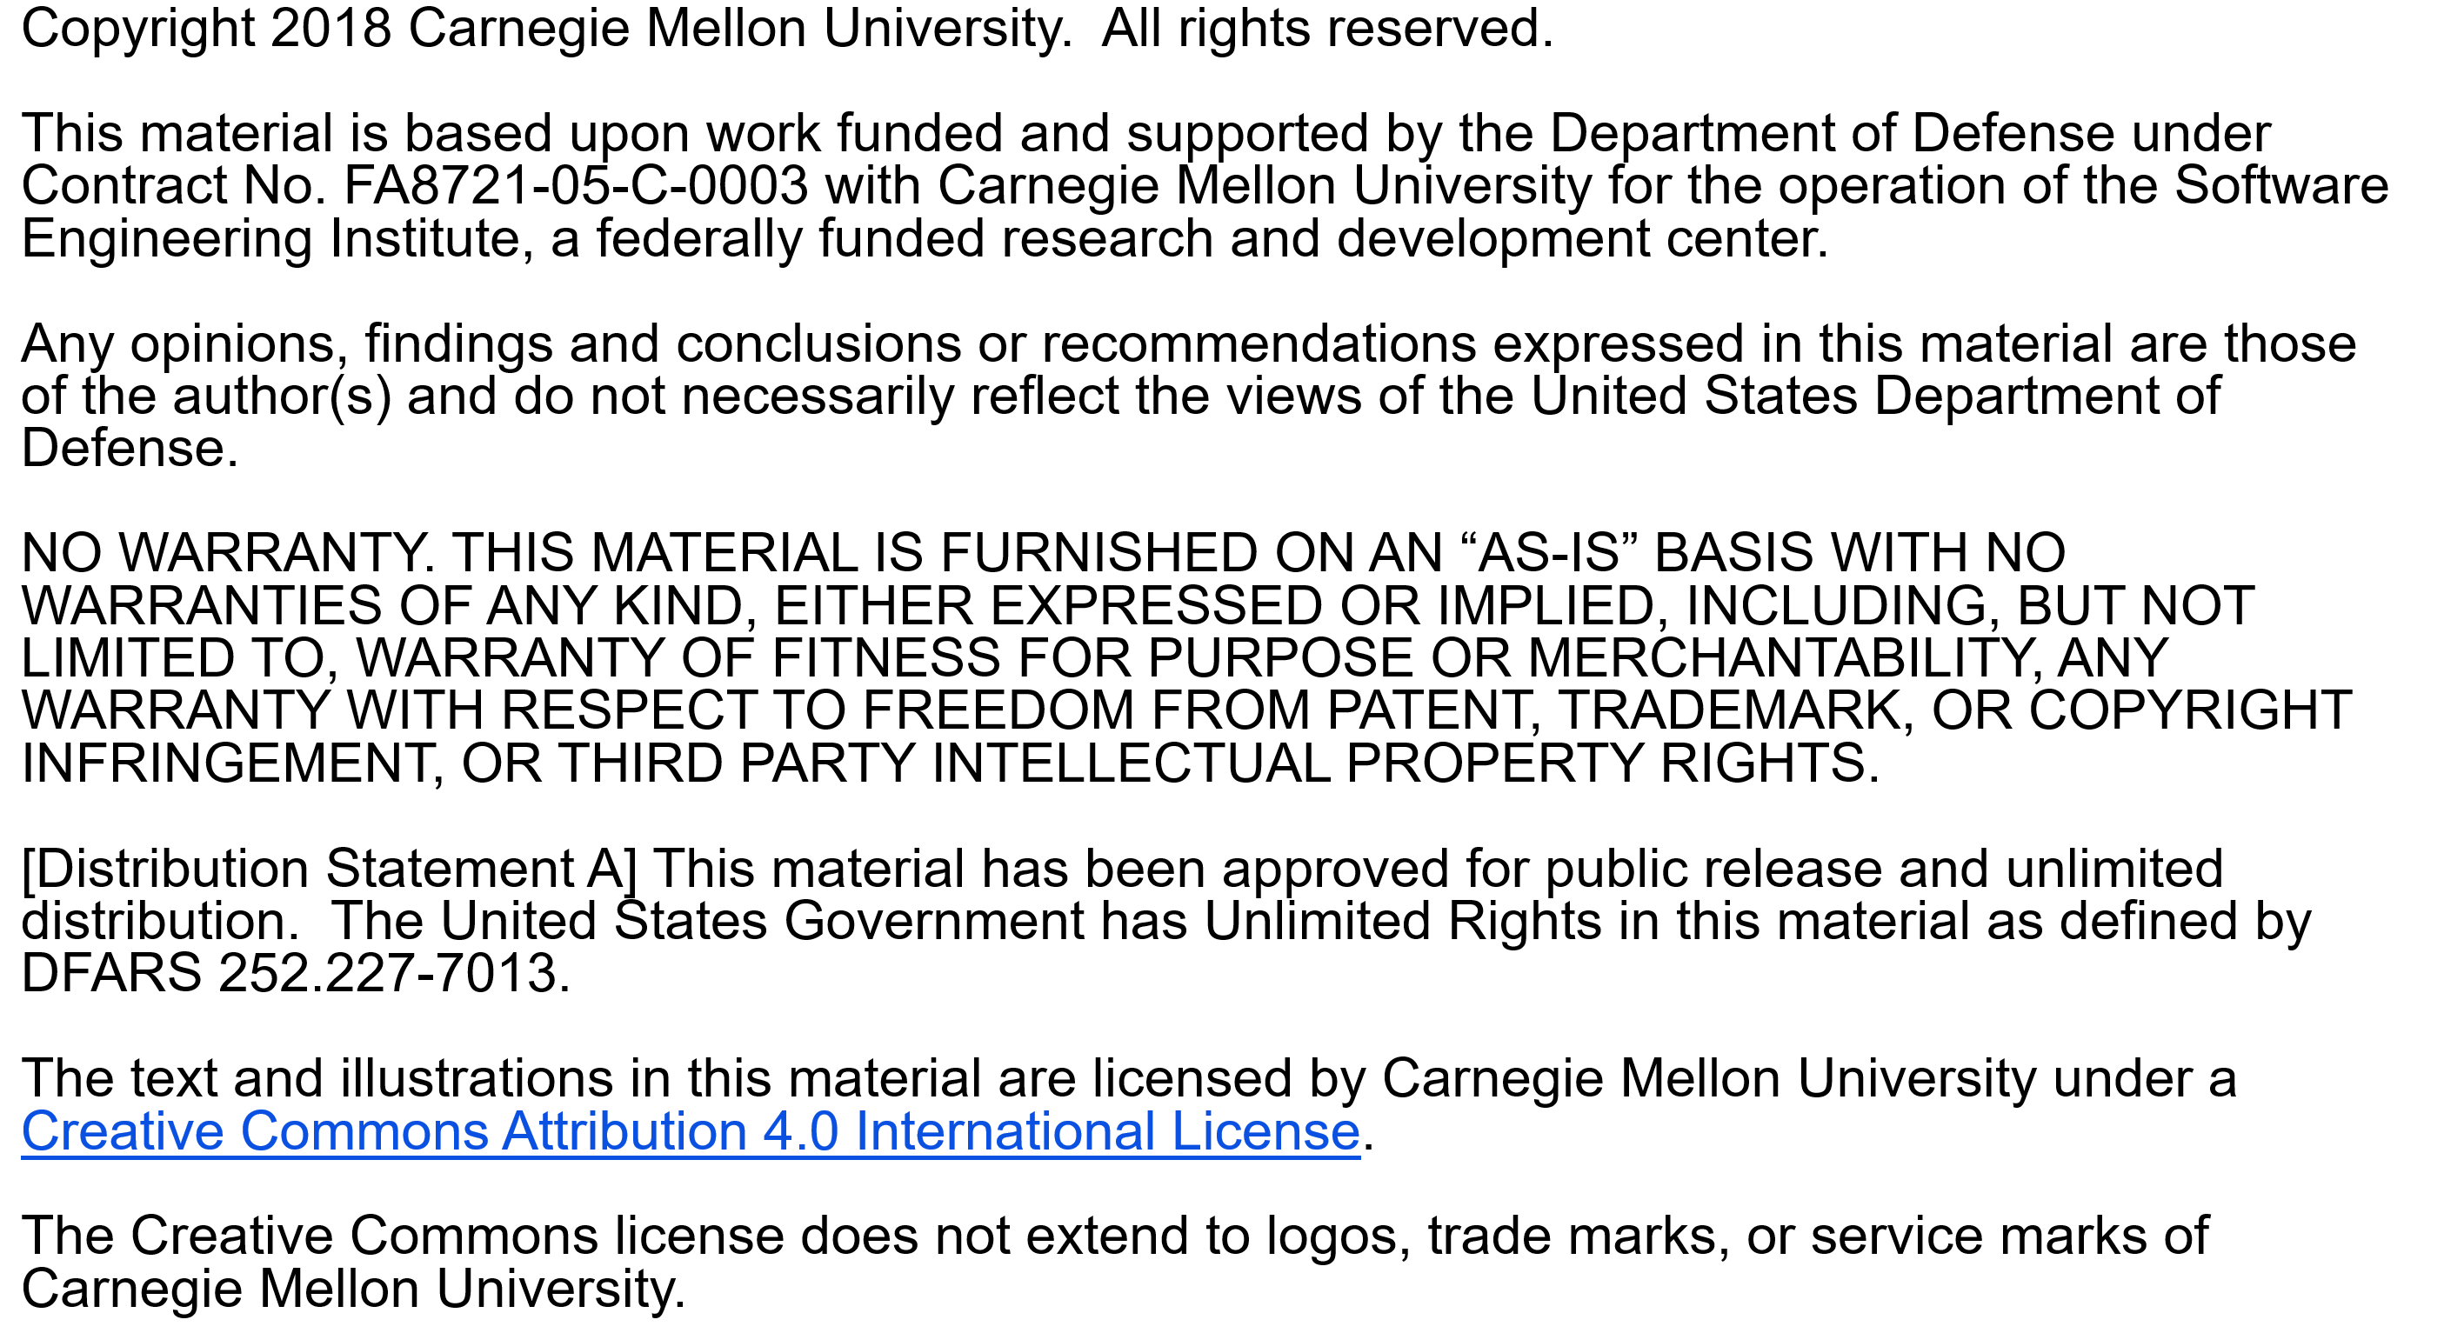

Slide 3
Copyright 2016 Carnegie Mellon University [Distribution Statement A] This material has been approved for public release and unlimited distribution. Please see Copyright notice for non-US Government use and distribution. This material is based upon work funded and supported by the Department of Defense under Contract No. FA8721-05-C-0003 with Carnegie Mellon University for the operation of the Software Engineering Institute, a federally funded research and development center. NO WARRANTY. THIS CARNEGIE MELLON UNIVERSITY AND SOFTWARE ENGINEERING INSTITUTE MATERIAL IS FURNISHED ON AN “AS-IS” BASIS. CARNEGIE MELLON UNIVERSITY MAKES NO WARRANTIES OF ANY KIND, EITHER EXPRESSED OR IMPLIED, AS TO ANY MATTER INCLUDING, BUT NOT LIMITED TO, WARRANTY OF FITNESS FOR PURPOSE OR MERCHANTABILITY, EXCLUSIVITY, OR RESULTS OBTAINED FROM USE OF THE MATERIAL. CARNEGIE MELLON UNIVERSITY DOES NOT MAKE ANY WARRANTY OF ANY KIND WITH RESPECT TO FREEDOM FROM PATENT, TRADEMARK, OR COPYRIGHT INFRINGEMENT. This material is distributed by the Software Engineering Institute (SEI) only to course attendees for their own individual study. Except for the U.S. government purposes described below, this material SHALL NOT be reproduced or used in any other manner without requesting formal permission from the Software Engineering Institute at permission@sei.cmu.edu. The U.S. Government's rights to use, modify, reproduce, release, perform, display, or disclose this material are restricted by the Rights in Technical Data-Noncommercial Items clauses (DFAR 252-227.7013 and DFAR 252-227.7013 Alternate I) contained in the above identified contract. Any reproduction of this material or portions thereof marked with this legend must also reproduce the disclaimers contained on this slide. Although the rights granted by contract do not require course attendance to use this material for U.S. Government purposes, the SEI recommends attendance to ensure proper understanding. Carnegie Mellon® is registered in the U.S. Patent and Trademark Office by Carnegie Mellon University. Personal Software ProcessSM, PSPSM, Team Software ProcessSM and TSPSM are service marks of Carnegie Mellon University. DM-0004310

Slide 4
Tutorial Objectives
After this tutorial, you will
understand the PSP0.1 process
know how to use the PSP0.1 process scripts and forms
be prepared to use PSP0.1 for program 2

Slide 5
PSP0.1 Objectives
The objectives of PSP0.1 are to help you to
measure the size of the programs that you produce
perform size accounting for the programs that you produce
make accurate and precise size measurements

Slide 6
New Process Elements
There are two new process elements.
process improvement proposal (PIP) form
size counting and coding standards
The project plan summary has been expanded.
a Program Size Summary section has been added
planned time in phase is calculated based on historical time in phase percentage

Slide 7
PSP0.1 Process Script Additions
The additions to the PSP0.1 process scripts include new steps for
estimating and reporting software size
distributing development time over planned project phases
using a size counting and coding standard
recording process problems and improvement ideas

Slide 8
Process Improvement Proposal -1
To improve your process, you will need to capture process problems and propose improvements for future reference.
You will need to know
any problems you have encountered in using the process
any suggestions you have for process improvements
your observations and findings from doing the assignments

Slide 9
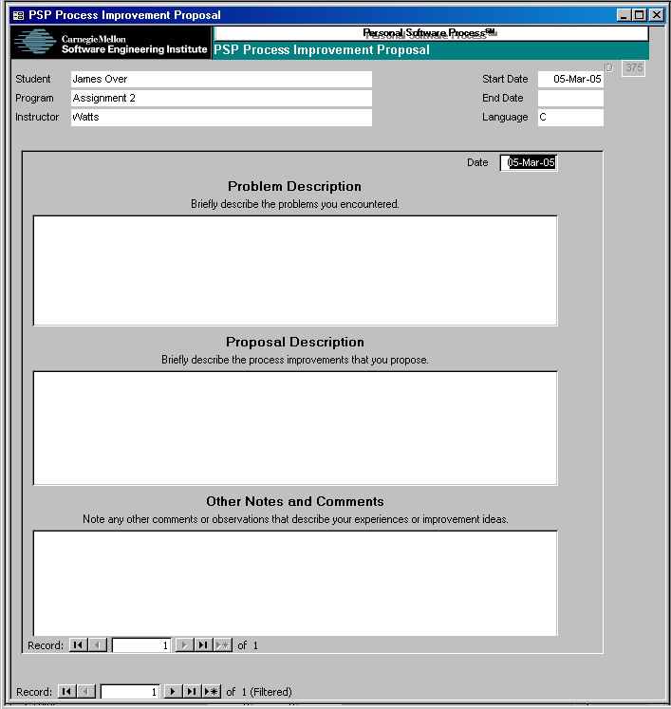
Process Improvement Proposal -2
You should complete a PIP form for each assignment.
The PIP holds process improvement information.
date
problem description
proposed solution
notes and comments

Slide 10
Coding and Counting Standards
Coding and size counting standards are needed to write the PSP programs.
These standards are
tailored to your language and needs
designed to make size counting easier
The coding standard defines quality-oriented exit criteria for the code phase.

Slide 11
PSP Software Size Measures
In the PSP, software size measures are used to
relate the amount of product produced with effort expended to project total effort
calculate productivity
normalize defects
project the total defects
Software size is measured in LOC.
To accurately relate size to effort, the different types of LOC in your program are counted separately.

Slide 12
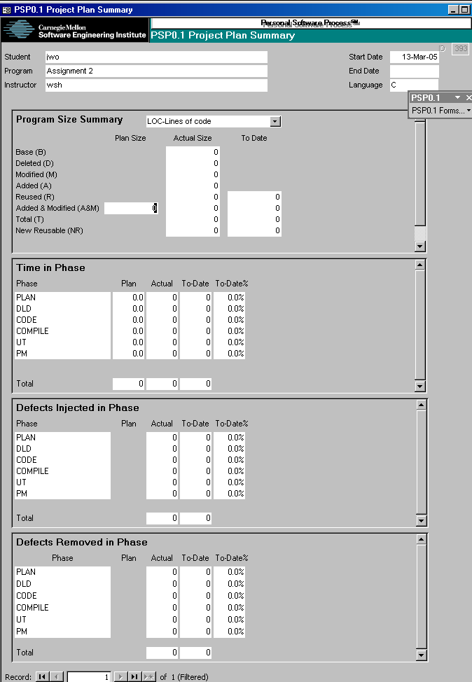
PSP0.1 Project Plan Summary
PSP0.1 adds the Program Size Summary for estimated and actual size data.
The types of size include
base [B]
deleted [D]
modified [M]
added [A]
reused [R]
added and modified [A+M]
new reusable

Slide 13
Program Size Type Relationships
Base program
New program
Added & Modified
Notes:
Possibly animate this diagram to introduce the pieces one at a time (new reused last)

Slide 14
Estimating Size
During planning
If this is an enhancement, measure the size of the base program and enter this in the Base (B) space under Actual.
Estimate the added and modified size and enter this in the Total Added and Modified (A+M) space under Plan.

Slide 15
Estimating Development Time
During planning
Enter estimated development time
Planned time in phase is then calculated based on the percentage of time in phase for all completed projects

Slide 16
Recording Size -1
During postmortem
Measure total program size and enter this in the Total Size (T) space under Actual.
Count the deleted size and enter this in the Deleted (D) space under Actual.
Count the modified size and enter this in the Modified (M) space under Actual.

Slide 17
Recording Size -2
During postmortem
Count the reused size and enter this in the Reused (R) space under Actual.
Count or estimate the number of new and changed size that will be added to the reuse library and in the New Reusable space under Actual.

Slide 18
Message to Remember
Your principal objective is to measure and estimate the size of the programs that you produce so that you can effectively plan and manage your work.

